Slide 1
Algorithmic step towards a clean city
Made by: Aayush Pandey (19AE10001)
Debdatta Hait (19EC10019)
Vikas Ahlawat (19EE30027)

Slide 2
Motivation…..
Following the Swacch bharat abhiyan by our honourable prime minister, all civic task forces have decided to work towards this mission of cleanliness….
But still the resources are not used in an optimised manner. In some places, there are more cleanliness amenities, in some there is a dearth.
So we have decided to make our small contribution using this project which places all the dustbins at a unified distance ‘k’ from each other thus optimising and thus effectively swapping over the entire area without wasting any of our resources….

Slide 3
Input and output specifications….
Input restrictions: We take into input the map of city represented by a weighted graph with edges representing the roads, the length of the road represented by the weight and vertices representing their point of intersection.
Assumptions:
All the roads are straight.
The length of the roads are integer.
Output restrictions: Our algorithm outputs the minimum number of dustbins to be installed in our city and the number of dustbins to be installed per road.

Slide 4
Pseudocode
BFS (G, s) //Where G is the graph and s is the source node
let Q be queue.
Q.enqueue( s ) //Inserting s in queue until all its neighbour vertices are marked.
mark s as visited.
visited[s]=true;
vertices[s].last_bin = 0; //we are installing a dustbin on this vertex
total++;
while ( Q is not empty)
//Removing that vertex from queue,whose neighbour will be visited now
s = Q.dequeue( )
//Now for each s we will traverse through all the edges connected to it
//and start installing the dustbin over that edge
For each edge e in adjacency list of s
{
weight = e.weight;
n = index of the other vertex connected to the edge e
int lastBin;
if(!e.visited){ //if the edge was not visited
e.visited = true; // assign edge to visited
dis = vertices[s].last_bin; // here last bin is the last dustbin installed before
(Continued in the next slide)

Slide 5
Pseudocode contd
if(weight>=(k-dis)){
weight-=(k-dis);
total += 1 + weight/k; //add these installed bins to the total
lastBin = weight - k*(weight/k); //now update the last bin for the next dustbin connected to this vertex
e.no_bin = 1+weight/k;
}
else{
if(weight>dis && dis!=0) vertices[s].last_bin = weight;
lastBin = weight + dis;
}
if(if we have not visited the next bin yet) vertices[n].last_bin = lastBin; //then update the last_bin value of that vertex
else if(vertices[n].last_bin=0 && lastBin=0){ // if we have already installed a bin on that vertex and we try to install there again then decrease one from the total
total--;
}
else if(lastBin==0) vertices[n].last_bin = 0; //if we are installing a bin on that vertex
else if(vertices[n].last_bin!=0 && lastBin!=0) vertices[n].last_bin = Math.max(vertices[n].last_bin, lastBin);
}
//processing all the neighbours of v
for all neighbours w of s in Graph G
if w is not visited
Q.enqueue( w ) //Stores w in Q to further visit its neighbour
mark w as visited.

Slide 6
Analysis
Time:
O(V(E+V)) is the time complexity because our main algorithm is basically a BFS with a while loop which iterates through all the edges connected to a vertex which can be at max V-1.
Space :
In our algorithm we are storing all the Vertices and Edges along with an adjacency list where for each vertex we are storing all edges ie O(V+E). Hence the complexity is O(V + E +(V+E)) or we can say O(V+E).

Slide 7

Input

Slide 8
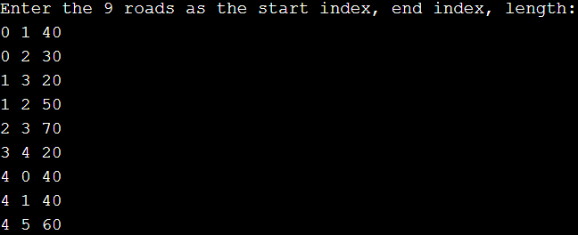
Input contd

Slide 9
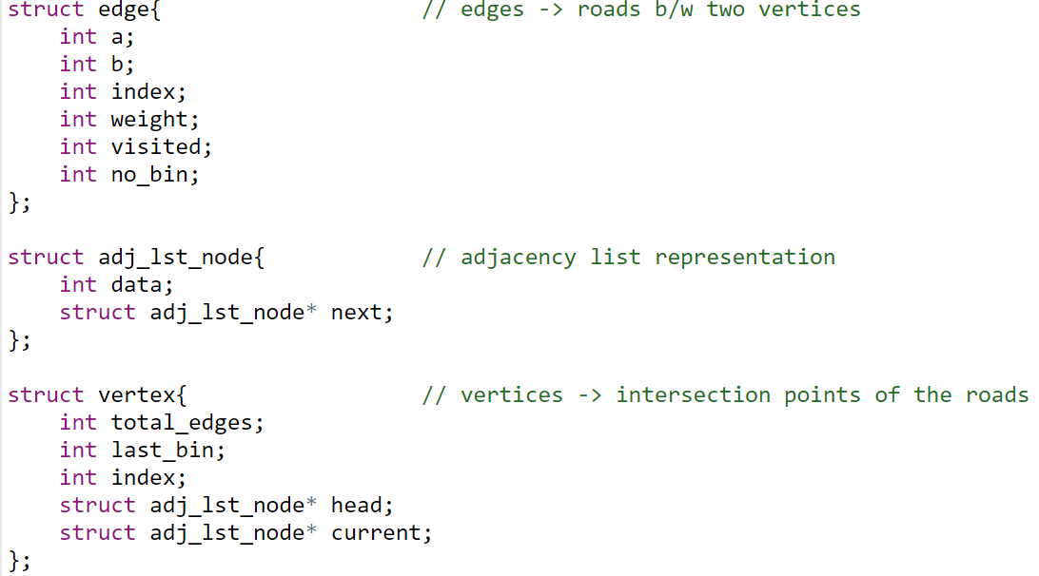
C implementation...

Slide 10
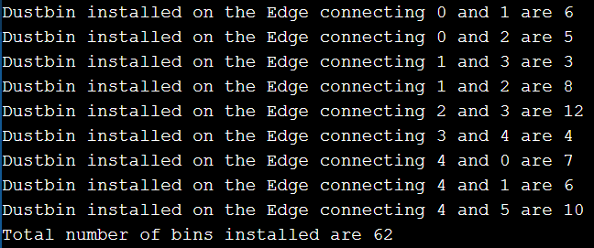
Output

Slide 11
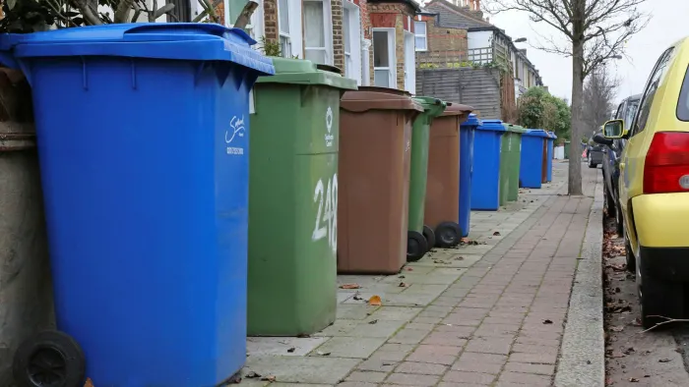
Impacts..
On further optimisation of our project considering into account bent roads and places with hotspots, our algorithm can help a lot in cleaning the environment which is a need in today’s time…..
THANK YOU FOR YOUR PRECIOUS TIME

